Slide 1
Lesson 6:
Loops / Decision Statements
By: Ryan Alterman
Revised: 9-8-17

Slide 2
Why do we use loops?
They allow us to execute blocks of code
Be it one time, or multiple
They require a few things:
An input value
A conditional statement
True
False
There are various kinds of loops
While
For
Do … while
nested

Slide 3
Conditional Code
If true
Condition
Input
If false
Output
The general structure of loops

Slide 4
The Loops
While Loops
Repeats the statements while the condition is true
Checks for condition before execution
For Loops
Executes the statements in the loops multiple times
Abbreviates the code that is in charge of the loop control
Do … While Loops
Like a while loop
Tests condition at the end instead
Nested Loops
Any loop that is inside another loop

Slide 5
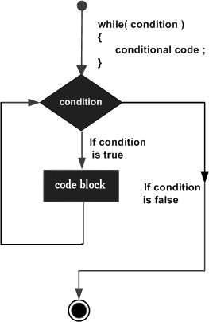
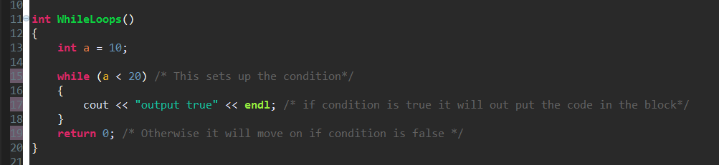
While Loops

Slide 6
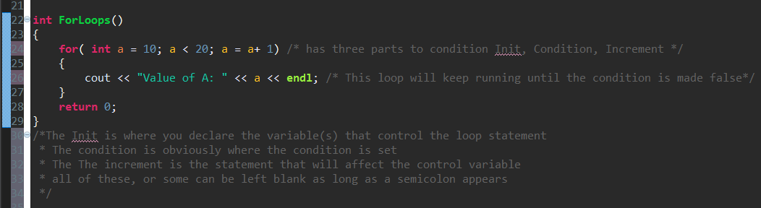
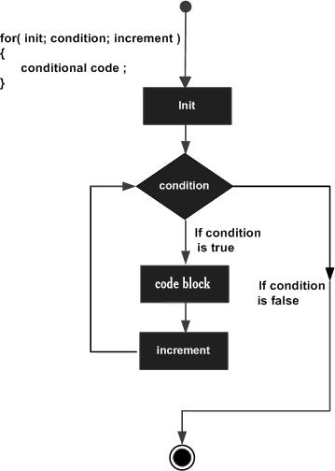
For Loops

Slide 7
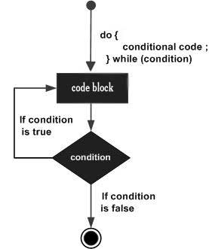
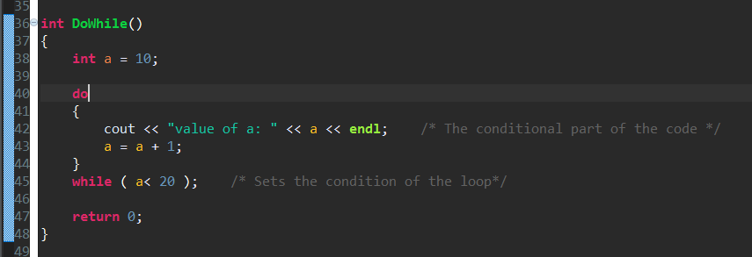
Do … while Loops

Slide 8
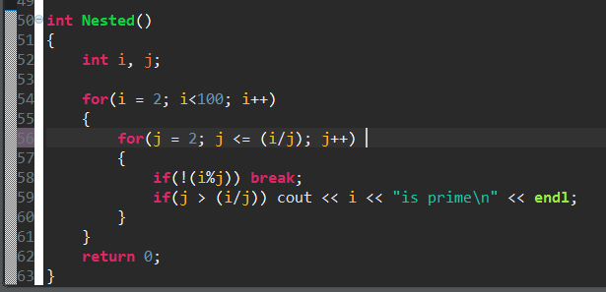
Nested Loops

Slide 9
Loop Control Statements
These are used to control the flow of loops
Break
Terminates the loop or switch statement
Immediately begins with next switch statement or loop
Continue
Forces the loop to retest the value of the loop
Goto
Transfers control to the labeled statement.

Slide 10
Infinite loops
Be cautious of this!
It can easily happen
If the value of the loop never becomes false
If this happens
Check the logic
Check the arithmetic
Check the conditions
When a conditional value is left out, the value is considered true
Always put a condition
Even if you want to make it always true; put a conditional value

Slide 11
What are decision statements?
Require more than one condition
Like other structures; they require statements to be executed
Conditional Code
If true
Condition
Input
If false
Output

Slide 12
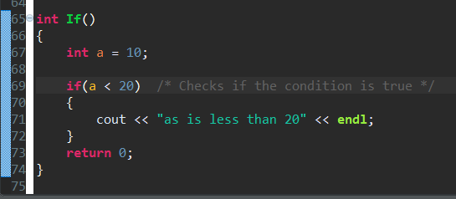
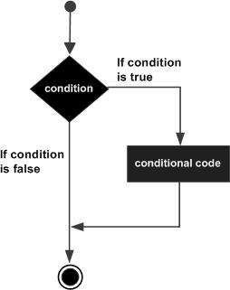
If Statements

Slide 13
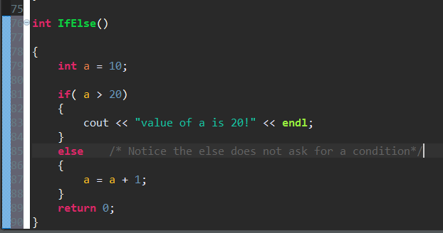
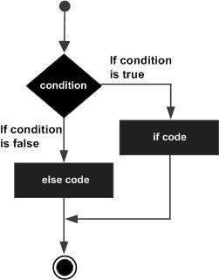
if … else statements

Slide 14
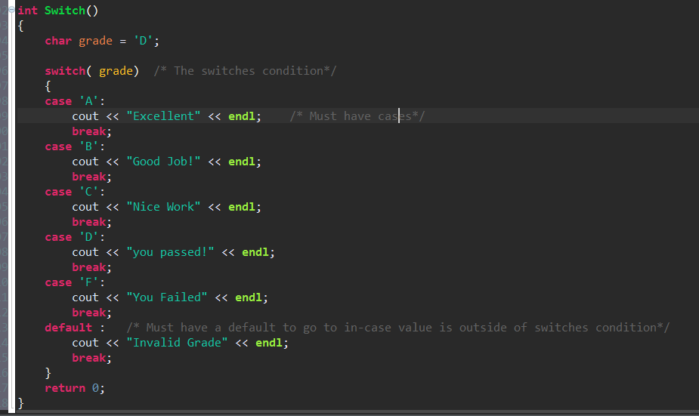
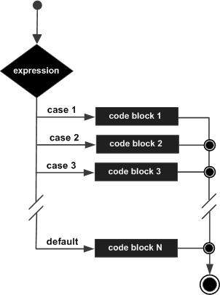
Switch Statements

Slide 15
One Final Note: These decision statements can be nested just like loops!

Slide 16
Challenge
I want you to make a program that utilizes loops and decision statements along with everything else we have learned in order to make a program that would pertain to real life. It can do anything you want, as long as it is APPROPRIATE! We will share these projects as a group when everyone is finished.

Slide 17
Next: Functions

